Slide 1




DIGITAL LITERACY
SKILLS
INTERMEDIATE USERS

Slide 2
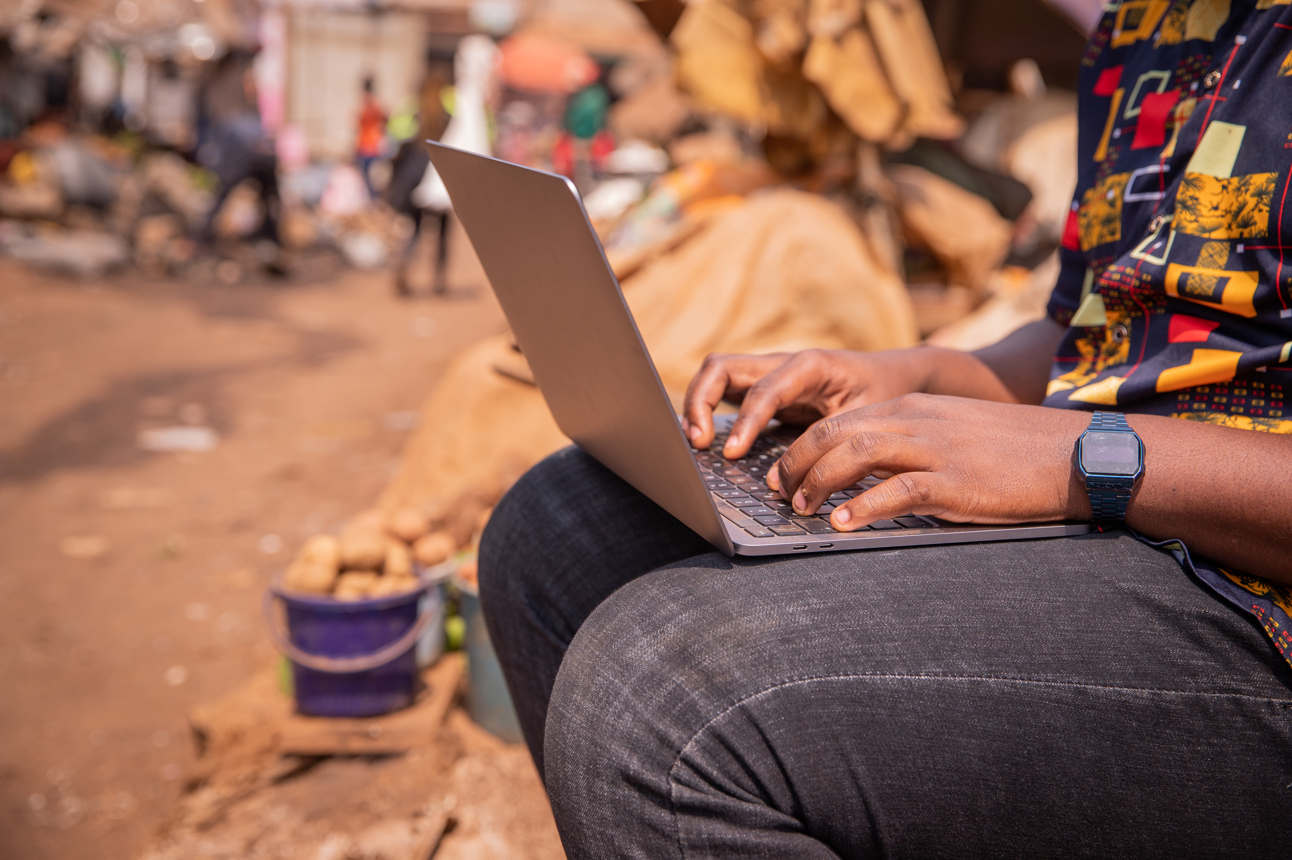
Module 3
Communication
and collaboration

Slide 3

6
Unit 6: Digital emotional intelligence

Slide 4

What is digital emotional intelligence?
How we feel affects the way that we navigate the digital world.
If we don’t communicate well on social media, it can also divide us and do harm.
When we communicate digitally, we can only interpret what we see on the screen of our device.
Our digital actions have real-world consequences.
We need to develop awareness and skills that help us navigate the digital world so that we can manage the positive and negative impact of interacting digitally.

Slide 5

Physical versus digital emotion indicators and tools
We need to learn how to interpret or read digital emotions.
Digital emotions spread faster than physical emotion because of the speed of digital communications.
Online communities allow messages to travel further and faster than they do in the physical world.

Slide 6

Interpersonal digital interaction
Whatever you write or post online can be found by others. You have a digital footprint that people can track.
Being polite shows respect. Being grateful for compliments, help, or advice shows respect.
Avoid gossip! Write clear, simple sentences.
Don’t swear, gossip, criticise, or condemn anyone online. Only use emoticons when you know what they mean.

Slide 7
Skills to practise
Resolve conflicts.
Communicate comfortably.
Help others feel better.
Set up a Zoom or Skype meeting with everyone in your class.
Choose a topic that is very controversial or problematic in your community.
Start the meeting by setting out the netiquette rules that should be followed during the meeting.
Agree on how you will resolve conflicting opinions without allowing the situation to become unpleasant.
Agree how you will allow others to express their opinions freely, even if you do not agree with them.
Agree how you will support those who feel uncomfortable.

Slide 8
All back covers should include
contact information of the section
producing the work.
© United Nations Children’s Fund (UNICEF) [month and year of publication]

